Slide 1

CIT-2180 Data and Database Management Chapter 8

Slide 2

Oracle 12C: SQL
Chapter 8
Restricting Rows and Sorting Data

Slide 3
WHERE Clause Syntax
A WHERE clause is used to retrieve rows based on a stated condition
Requires:
Column name
Comparison operator
Value or column for comparison
Values are case sensitive
Date values must be of the form ‘DD-MON-YY’
3

Slide 4
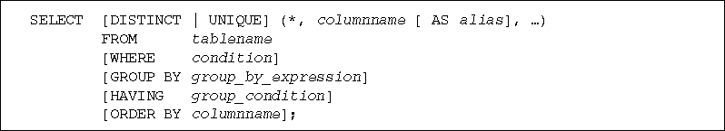
SELECT Statement Syntax (continued)
What is a condition?
<column name><comparison operator><another named column or a value>
4

Slide 5
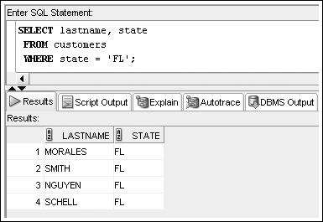
WHERE Clause Example
List WHERE clause after FROM clause
Enclose nonnumeric data in single quotes
5

Slide 6
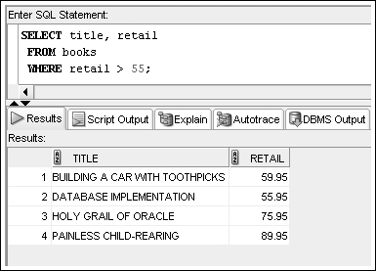
Comparison Operators
Creates expressions that evaluate to T or F
6

Slide 7
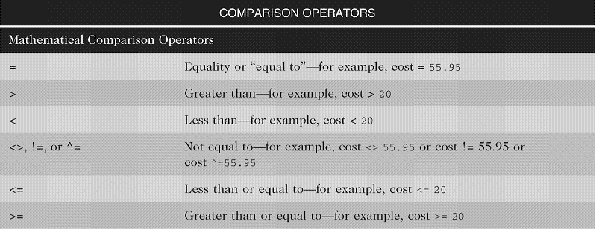
Arithmetic Comparison Operators
7

Slide 8
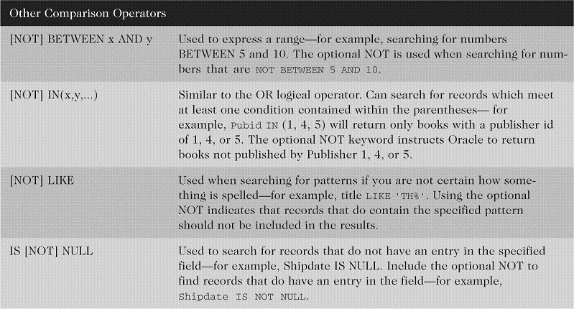
Other Comparison Operators
8

Slide 9
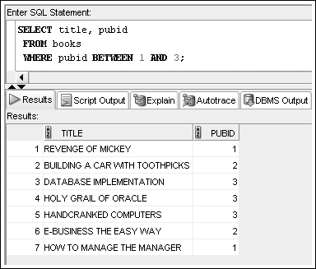
BETWEEN…AND Operator Example
9

Slide 10
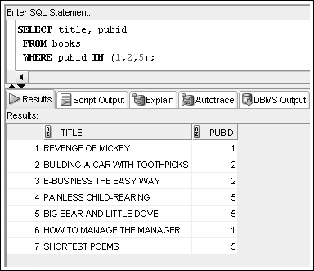
IN Operator Example
10

Slide 11
LIKE Operator
Performs pattern searches
Used with wildcard characters
Underscore (_) for exactly one character in the indicated position
Percent sign (%) represents any number of characters (zero or more characters)
11

Slide 12
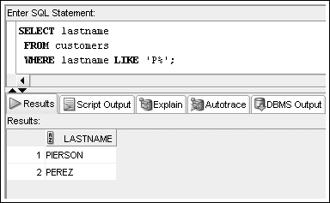
LIKE Operator Example
12

Slide 13
Logical Operators
Used to combine conditions
Evaluated in order of NOT, AND, OR
NOT – reverses meaning
AND – both conditions must be TRUE
OR – at least one condition must be TRUE
13

Slide 14
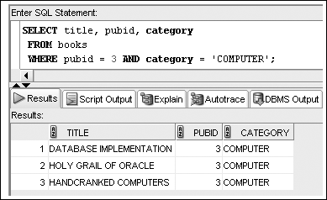
AND Logical Operator Example
14

Slide 15
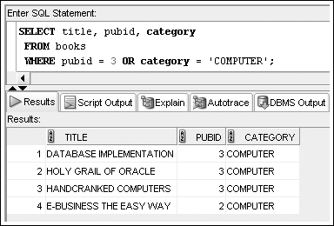
OR Logical Operator Example
15

Slide 16
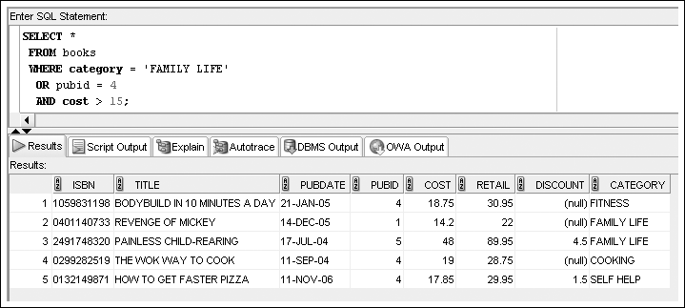
Multiple Logical Operators
Resolved in order of NOT, AND, OR
16

Slide 17
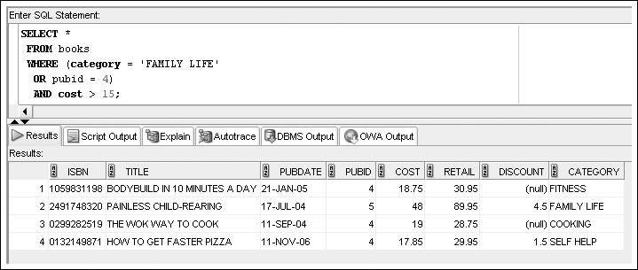
Multiple Logical Operators
Use parentheses to override the order of evaluation
17

Slide 18
Resolving Multiple Types of Operators (order of operations)
Arithmetic operators
Comparison operators
Logical operators
18

Slide 19
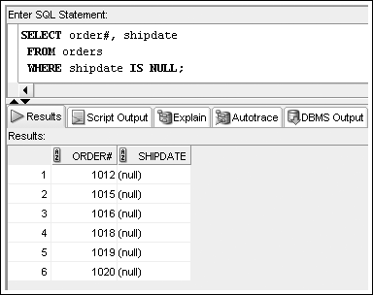
Treatment of NULL Values
Requires use of IS NULL operator (absence of data)
19

Slide 20
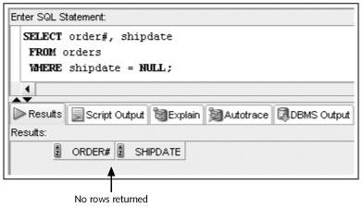
Treatment of NULL Values (con’t)
Common error is using = NULL, which does not raise an error but also does not return any rows
20

Slide 21
SELECT Statement Syntax (revisited)
What is a condition?
<column name><comparison operator><another named column or a value>
21

Slide 22
ORDER BY Clause Syntax
The ORDER BY clause presents data in sorted order
Ascending order is default
Use DESC keyword to override column default
255 columns maximum
22

Slide 23
ORDER BY Clause Syntax Sort Sequence
In ascending order, values will be listed in the following sequence:
Numeric values
Character values
NULL values
In descending order, sequence is reversed
23

Slide 24
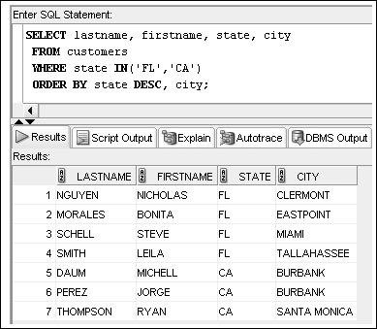
ORDER BY Example
24

Slide 25
Oracle 12C: SQL
END OF Chapter 8
Restricting Rows and Sorting Data

